Slide 1
Chapter 11
Simple Linear Regression and Correlation

Slide 2
Correlation
Correlation
relationship between two variables
Chap 3-<number>

Slide 3
Positive and Negative Correlations
A positive relationship exists when both variables increase or decrease at the same time. (Weight and height).
X and Y tend to move in the same direction
Negative Correlation
A negative relationship exist when one variable increases and the other variable decreases or vice versa. (Demand and price).
X and Y tend to move in opposite directions
Chap 3-<number>

Slide 4
Correlation
A scatter diagram can be used to show the relationship between two variables
Correlation analysis is used to measure strength of the association (linear relationship) between two variables
Chap 13-<number>

Slide 5
Scatter Plots of Data with Various Correlation Coefficients
Y
Y
Y
X
X
X
r = -1
r = -.6
r = 0
Y
Y
Y
X
X
X
r = +1
r = +.3
r = 0

Slide 6
Types of Relationships
(continued)
Strong relationships
Weak relationships
Y
Y
X
X
Y
Y
X
X
Basic Business Statistics, 10e © 2006 Prentice-Hall, Inc.
Chap 13-<number>

Slide 7
Types of Relationships
(continued)
No relationship
Y
X
Y
X
Chap 13-<number>

Slide 8
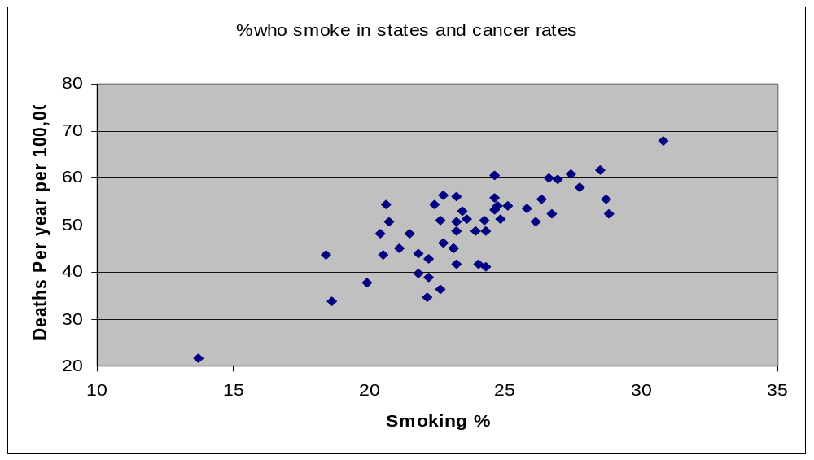
Scatter Plots

Slide 9
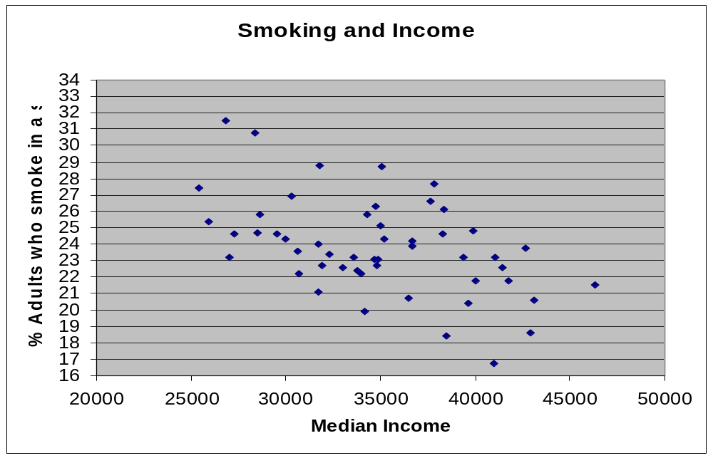
Scatter Plots
Chap 3-<number>

Slide 10
Scatter Plots
Over
30
28
26
24
22
20
18
16
14
12
10
8
6
4
2
◆
◆
◆
◆
◆
◆
◆
◆
◆
◆
◆
◆
5
10
15
20
25
30
35
40
45
50
55
60
65
70
Over
◆
◆
◆
◆
◆
◆
◆
◆
◆
◆
◆
◆
◆
◆
◆
◆
◆
◆
◆
◆
◆
◆
◆
◆
◆
◆
◆
◆
◆
Number of CDs in house
◆
◆
◆
◆
◆
◆
◆
◆
◆
◆
◆
◆
◆
◆
◆
◆
◆
◆
◆
◆
◆
◆
◆
◆
◆
◆
◆
0
Age of persons in household
Chap 3-<number>

Slide 11
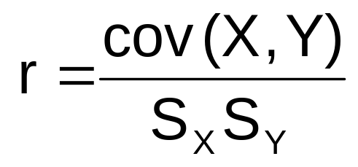
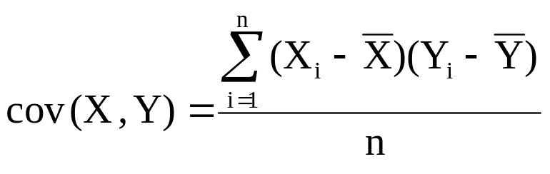
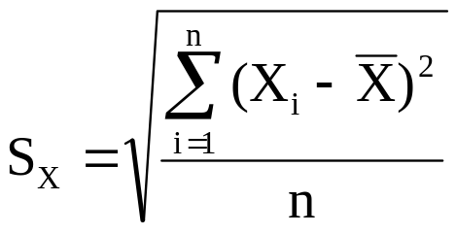
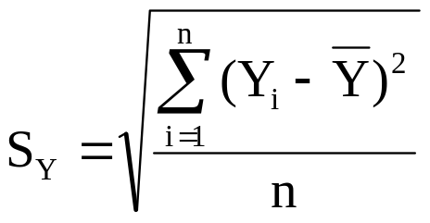
Coefficient of Correlation
Measures the relative strength of the linear relationship between two variables
Sample coefficient of correlation:
where

Slide 12
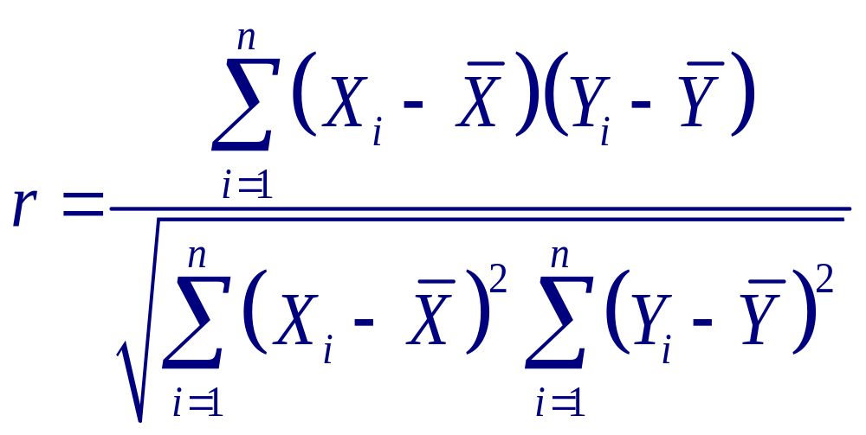
Coefficient of Correlation

Slide 13
Features of
Correlation Coefficient, r
Unit free
Ranges between –1 and 1
The closer to –1, the stronger the negative linear relationship
The closer to 1, the stronger the positive linear relationship
The closer to 0, the weaker the linear relationship

Slide 14
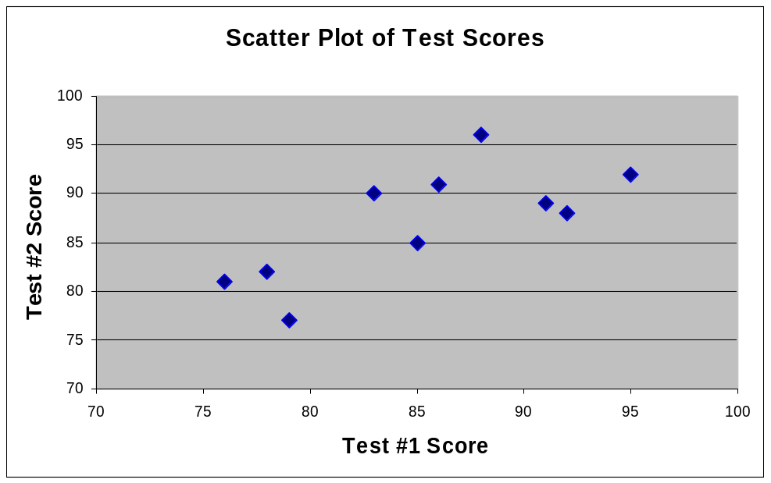
Interpreting the Result
r = .733
There is a relatively
strong positive linear
relationship between
test score #1
and test score #2
Students who scored high on the first test tended to score high on second test, and students who scored low on the first test tended to score low on the second test

Slide 15
The Bank of Lincoln is interested in reducing the amount of time people spend waiting to see a personal banker. The bank is interested in the relationship between waiting time Y in minutes and number of bankers on duty X. customers were randomly selected with the given data below:
Plot a scatter diagram
Calculate correlation coefficient
Chap 3-<number>

Slide 16
X | Y
2 | 12.8
3 | 11.3
5 | 3.2
4 | 6.4
2 | 11.6
6 | 3.2
1 | 8.7
3 | 10.5
4 | 8.2
3 | 11.3
3 | 9.4
X | Y
2 | 12.8
4 | 8.2
Chap 3-<number>

Slide 17
Properties of correlation
r is symmetrical with respect to variable x and y.
r lies between -1 to +1
Correlation coefficient is independent of origin and scale.
r= √byx.bxy
Chap 3-<number>

Slide 18
Introduction to
Regression Analysis
Regression analysis is used to:
  Predict the value of a dependent variable based on the value of at least one independent variable
  Explain the impact of changes in an independent variable on the dependent variable
Dependent variable: the variable we wish to predict
or explain
Independent variable: the variable used to explain the dependent variable
Chap 13-<number>

Slide 19
Simple Linear Regression Model
Only one independent variable, X
Relationship between X and Y is described by a linear function
Changes in Y are assumed to be caused by changes in X
Chap 13-<number>

Slide 20
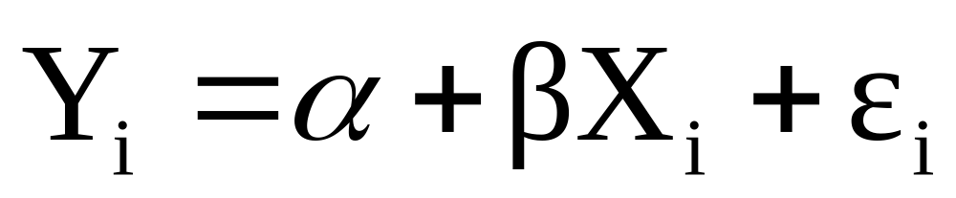
Simple Linear Regression Model
Population Slope
Coefficient
Random Error term
Population
Y intercept
Independent Variable
Dependent Variable
Linear component
Random Error
component
Chap 13-<number>

Slide 21
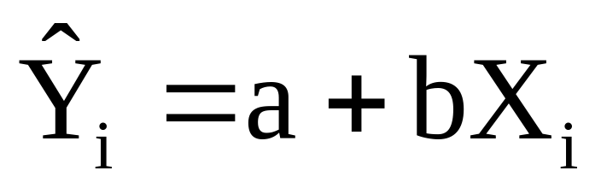
Simple Linear Regression Equation (Prediction Line)
The simple linear regression equation provides an estimate of the population regression line
Estimated (or predicted) Y value for observation i
Estimate of the regression
intercept
Estimate of the regression slope
Value of X for observation i
The individual random error terms e_{i} have a mean of zero
Chap 13-<number>

Slide 22
Example: Salary and Experience
Salary vs. Years Experience
  For n = 6 employees
  Linear (straight line) relationship
  Increasing relationship
    higher salary generally goes with higher experience
  Correlation r = 0.8667
Mary earns $55,000
per year, and has
20 years of experience
Experience
15
10
20
5
15
5
Salary
30
35
55
22
40
27
60
50
40
Salary ($thousand)
30
20
0
10
20
Experience
Chap 13-2

Slide 23
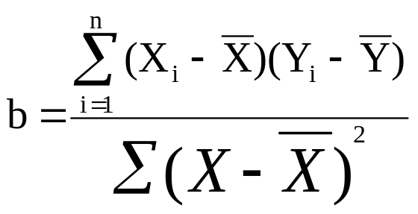
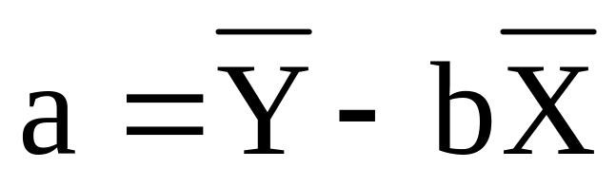
example
Chap 3-<number>

Slide 24
The Least-Squares Line Y=a+bX
Summarizes bivariate data: Predicts Y from X
  with smallest errors (in vertical direction, for Y axis)
  Intercept is 15.32 salary (at 0 years of experience)
  Slope is 1.673 salary (for each additional year of experience, on average)
60
Salary = 15.32 + 1.673 Experience
50
40
Salary (Y)
30
20
10
0
10
20
Experience (X)
Chap 13-<number>

Slide 25
Predicted Values and Residuals
Predicted Value comes from Least-Squares Line
  For example, Mary (with 20 years of experience)
  has predicted salary 15.32+1.673(20) = 48.8
    So does anyone with 20 years of experience
Residual is actual Y minus predicted Y
  Mary’s residual is 55 – 48.8 = 6.2
    She earns about $6,200 more than the predicted salary for a person with 20 years of experience
    A person who earns less than predicted will have a negative residual

Slide 26
Coefficient of Determination R²
  Tells what percent of the variability (variance) of Y is explained by X
  Example: R² = 0.8667² = 0.751
    Experience explains 75.1% of the variation in salaries
Chap 3-<number>

Slide 27
Problem 12-63
Starting salary $ | 36 | 30 | 30 | 24 | 27 | 33 | 21
GPA | 4.0 | 3.0 | 3.5 | 2.0 | 3.0 | 3.5 | 2.5
Plot a scatter diagram.
Estimate least square regression equation.
Draw regression line.
Chap 3-<number>

